Slide 1
Plasma based Integrated On-chip Antenna
Hasan T. Abbas and Robert D. Nevels

Slide 2
Outline
2D Plasmonic materials
Dyakonov-Shur Instability
Radiative Emission
Radiation Detection
Thermal Effects
Directivity Enhancement
Current state-of-the-art
Comparison with Graphene

Slide 3
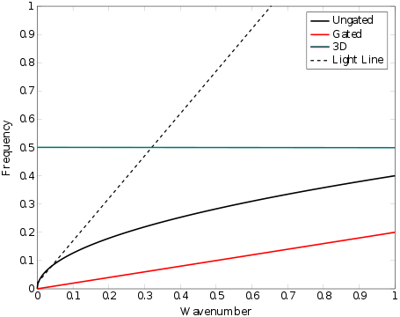
Terahertz Plasmons 3D vs 2D
3D
Found in Bulk Metals
No dispersion at terahertz or microwave frequencies
2D
Found in semiconductor heterostructures and graphene
Extreme sub-wavelength confinement
Reduced circuit dimensions
Notes:
Owing to the difficulties in engineering Graphene in bulk and the its high cost, we focus on the 2DEG found in semiconductor heterojunction that are formed naturally in the fabrication process.

Slide 4
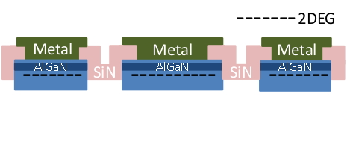
The 2DEG plasmon
Semiconductor Heterostructure
2 Dimensional Electron Gas (2DEG) formed at the heterojunction
Junction materials have different bandgaps
GaN/AlGaN and GaAs/AlGaAs commonly used
High Electron Mobility Transistor (HEMT) incorporates 2DEG as a channel

Slide 5
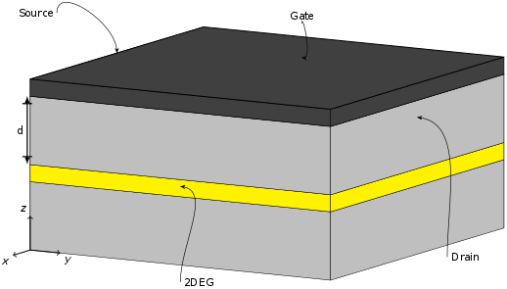
Dyakonov-Shur Instability
Transistor channel can become unstable when properly biased
Asymmetric boundary conditions on the channel (source – short circuited, drain – open circuited) lead to laser-like phenomena
Resonant amplification of plasma waves in the 2DEG leads to radiative emission
Notes:
Electron flow in a 2DEG is of ballistic nature. Means, the flow (or the current) starts to shoot in the saturation region.

Slide 6
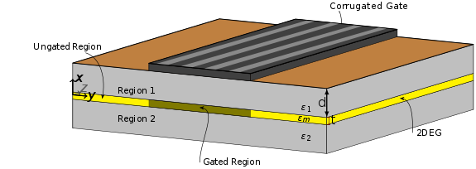
Radiative Emission
Gated and ungated regions have different plasma frequencies
With contemporary HEMT dimensions, plasma waves are generated in the low terahertz region.

Slide 7
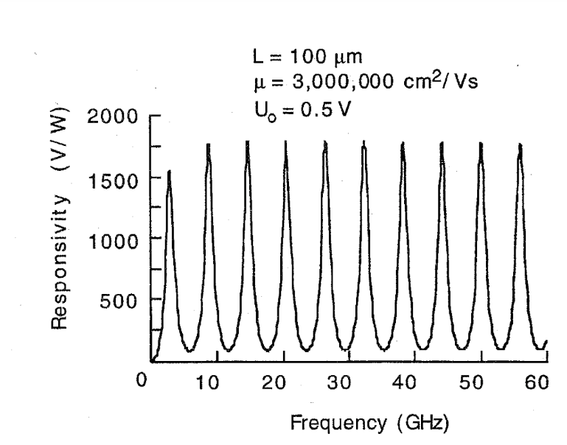
Radiation Detection
Incident electromagnetic waves couple with the 2DEG plasma waves
Enhanced plasma oscillations induce a dc voltage across the drain and source terminals.
The detector response displays a modal behavior
Dyakonov, M.; Shur, M., "Detection, mixing, and frequency multiplication of terahertz radiation by two-dimensional electronic fluid," in Electron Devices, IEEE Transactions on , vol.43, no.3, pp.380-387, Mar 1996

Slide 8
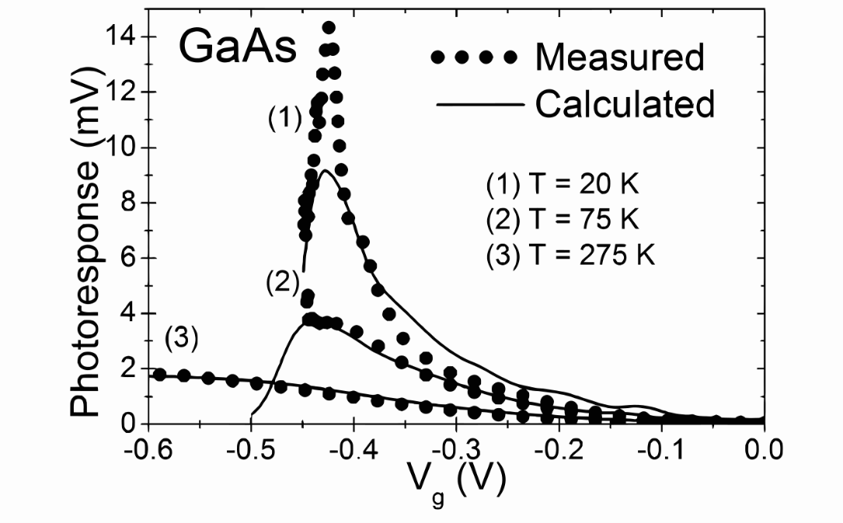
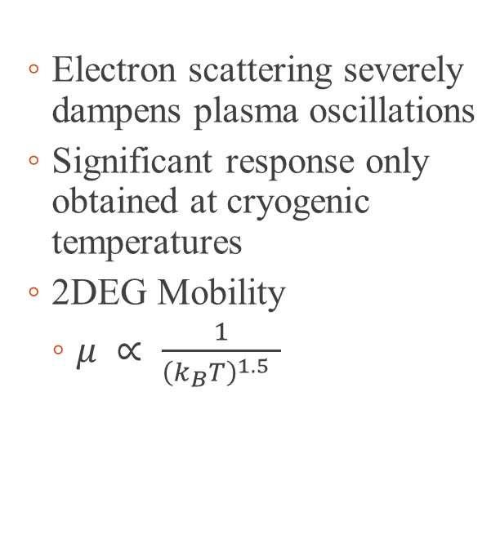
Thermal Effects
Electron scattering severely dampens plasma oscillations
Significant response only obtained at cryogenic temperatures
2DEG Mobility
$μ ∝ \frac{1}{{\left(k_{B}T\right)}^{1.5} }$
Klimenko, O. A. et al., “Temperature enhancement of terahertz responsivity of plasma field effect transistors,” in Journal of Applied Physics,112, 014506 , 2012.

Slide 9
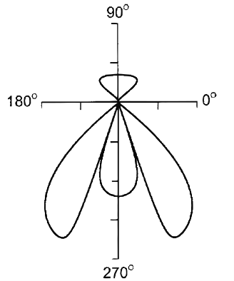
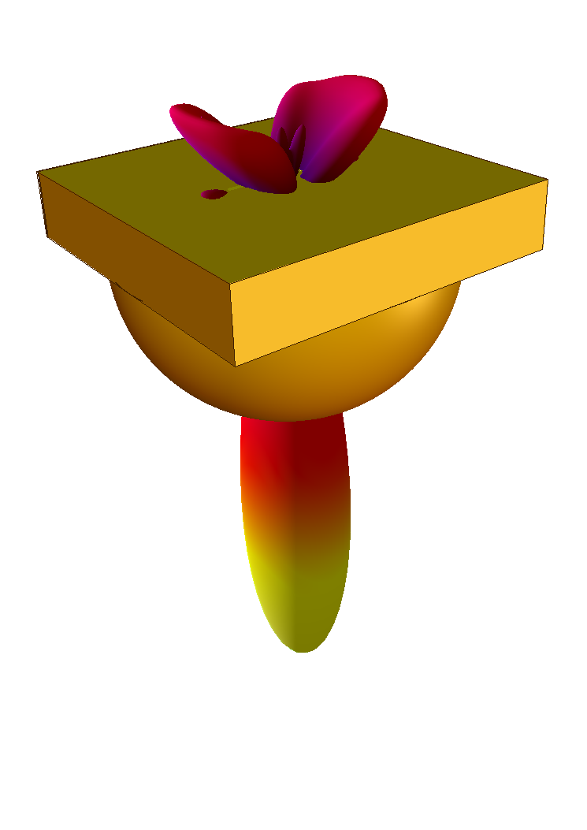
Directivity Enhancement
Radiation into the semiconductor layers
Silicon lens commonly used to focus radiation through the dielectric
Popov, V. V. et al., “Resonant excitation of plasma oscillations in a partially gated two-dimensional electron layer,” in Journal of Applied Physics,98, 033510 , 2005.
Notes:
Resonant excitation of plasma oscillations in a partially gated two-dimensional electron layerPopov, V. V. and Polischuk, O. V. and Shur, M. S., Journal of Applied Physics, 98, 033510 (2005), DOI:http://dx.doi.org/10.1063/1.1954890

Slide 10
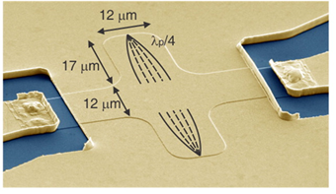
Plasmonic Terahertz Devices
Similar to Surface Plasmon Polaritons (SPP) in the optical domain, 2D plasmons assist in extreme subwavelength confinement
Miniaturization of transmission lines and antenna
Andress, W. A. et al., “Ultra-Subwavelength Two-Dimensional Plasmonic Circuits,” in Nano Letters vol. 12 no. 5, pp. 2272-2277, 2012.

Slide 11
2DEG vs Graphene
2DEG
Graphene
Well-established manufacturing process
Inherent to High Electron Mobility Transistors
Low-cost
Integrable
Difficult to engineer
Not grown on semiconductor substrates
Difficult to integrate
High cost
‘Contamination’ diminishes the exotic characteristics

Slide 12
Conclusion
Instability of resonant plasma waves in a 2DEG results in terahertz radiation
On-chip antenna in the terahertz region can be designed
Engineering of special materials displaying low loss at room temperatures required
Resonant wavelength in a 2DEG much shorter than a metal dipole counterpart
Antenna miniaturization

Slide 13
Questions?

